Slide 1

K6 Performance WEB API & REST API Performance testing FRAMEWORK
Persistent Systems Quality Engineering

Slide 2
WEB API – MountSinai.org
A large non -profit Network chain of Hospitals , Healthcare Solutions with focus on Medtech.
Demo API Application & Scenarios
API Application Targeted – Mountsinai.org
Demo Scenarios Targeted:
Find Doctor
Book Appointment
Search by Specialization
ICAHN Home Page,Search and Faculty Search
PS NOTE : Docker Imaging , Containerization of solution with Pipeline is in progress
Tool Environment:
Jenkins CI with Performance Plugins
Apache Jmeter 5.5.4 with Extended Plugins
Master Single Node
Influx Time Series Database
Grafana Dashboard
Jmeter Backend Listener
Targeted Environment Parameters:
Test Data CSV,User Defined Variables and other test parameters using JSON Shared Array
Logical Handling and Enhancements incorporated for scripts consisting Checks, Errorrate, Assertions, Threshold etc.

Slide 3
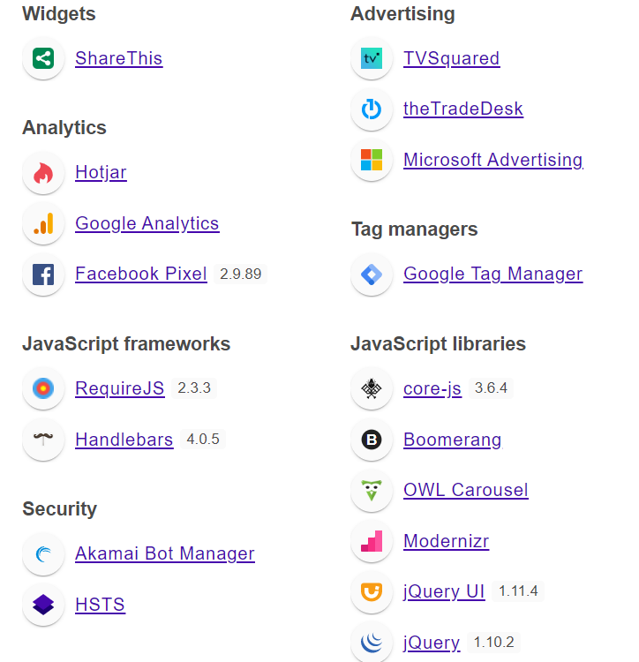
MOUNTSINAI.ORG PROD TECHNOLOGY

Slide 4
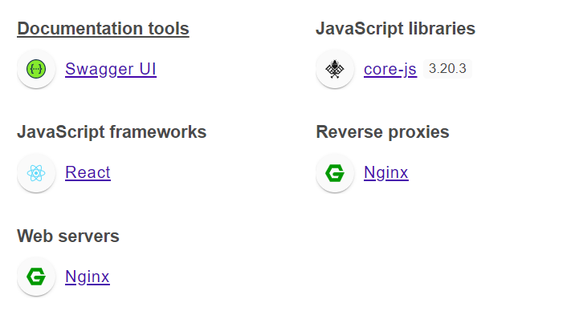
PETSTORE REST API - TECHNOLOGY

Slide 5
K6 – Javascript API Performance
API Service creation – Registering Available services of Petstore
Javascript K6 packages
K6 Cloud Loadgenerators and SAAS offering
K6 & REST API
JSON API INPUT (GET,POST,DELETE or PUT)
J
E
N
K
I
N
s
InfluxDB
Grafana
K6 JS Onpremise
Text API
INPUT
(GET,POST,DELETE or PUT)
Eclipse / Visual studio (IDE)
Gitlab Source Code Repository

Slide 6
RESTAPI – PETSTORE (CREATE,READ,UPDATE ,DELETE)
Petstore REST API developed on Swagger
REST API Userpayload:
Create a Username, User Profile
POST User ID
Update Username, ID
Delete Username, ID
Tool Environment:
Jenkins CI with Performance Plugins
Apache Jmeter 5.5.4 with Extended Plugins
Master Single Node
Influx Time Series Database
Grafana Dashboard
Jmeter Backend Listener
Targeted Environment Parameters:
Test Data CSV,User Defined Variables and other test parameters using JSON Shared Array
Logical Handling and Enhancements incorporated for scripts consisting Checks, Errorrate, Assertions, Threshold etc.

Slide 7
K6 with Grafana , InfluxDB and Jenkins - USP
Feature | Jmeter | K6
Written in | Java | Go
Scripting language | Limited: some Java (Groovy, Beanshell, etc) | Javascript
Protocols | Supports most protocols via plugins (native support for HTTP/1.1, SOAP, FTP, JDBC, LDAP, MOM via JMS, SMTP, POP3, IMAP, shell scripts, TCP, Java objects) | Supports fewer, modern protocols natively (HTTP/1.1, HTTP/2, WebSockets, gRPC)
Browser automation | Yes, using Selenium/WebDriver | Yes, using xk6-browser
External dependencies | Java | none
Source Code | Link | Link

Slide 8
K6 with Grafana , InfluxDB and Jenkins - USP
Features | Jmeter | K6
Resource utilization | Poor; One load generator can simulate a few thousand virtual users | Very good; One load generator can simulate tens of thousands of virtual users
Memory management | JVM heap memory must be set | Uses load generator memory natively
Threading model | 1 Thread: 1 Virtual User; Slower performance, higher resource cost | 1 Goroutine: 1 Virtual User; Faster performance, lower resource cost
Ease of scripting | GUI-driven, with code blocks | code-driven; VSCode plugin
Test-level thresholds | No, individual request only | Yes
Script format | XML | javascript
Collaboration | Difficult to work on simultaneously; tester-friendly; need the GUI app to edit | Developer-friendly, easy to version; Javascript format promotes collaboration
Maintenance | Verbose scripts; XML format is difficult to read | More concise scripts; JavaScript is easy to read
Community | Since 1998; Many third-party tutorials; Extensive documentation; No central community | Since 2017; Extensive documentation; Fewer third-party tutorials; Official community
Plugin support | Requires plugins for many features, but there are lots of plugins available | Most features are natively supported, but plugin support is new and availability is sparse
Distributed load generation | Yes | Yes (via k6 Operator)
Pre-generated reports | Default and custom HTML reports; logging via listeners | No built-in pre-generated reports; integration with analytics tools with third-party dashboards
Website | jmeter.apache.org | k6.io

Slide 9
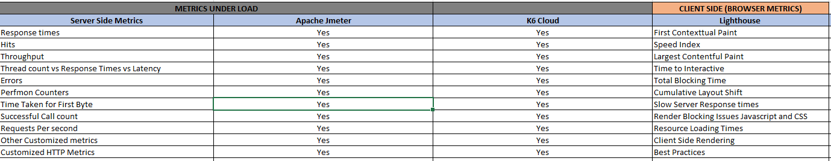
Tool Metrics Reporting Comparison – Lighthouse vs jmeter vs k6
Performance Test Metrics Reporting – Server-Side vs Client Side

Slide 10
USAGE STEPS – HOW TO USE?
Version 1 Jenkins Master CI with UI defined Pipeline Executions
5. Ensure all steps specified in Get README is followed.
6. Kick of Jenkins Build, Monitor Console for Pass/Fail Runs
7. IF Build Fails take necessary steps to Debug the Pipeline.
8. If Job runs successfully, Check if all artifacts are archived in Workspace including HTML Reports .
9. Monitor the Real time Test Data containing Transactional data, System and Application Counters logged in Grafana
Grafana – http: <ipaddress of host>:3000
Influxdb – http: <ipadress of host>: 8086
Steps to Solution:
Download the Project Repository from GitHub. Currently individual Git Credentials are used for cloning.
Follow the Jenkins Build Steps or Create a Freestyle Jenkins Project/Copy from existing build.
Configure InfluxDB, Grafana Plugins in Manage Jenkins, Set Environment Variables and Tool Configurations.
Use appropriate k6 CLI command on Jenkins “Build” as per Operating System
Steps to Solution:

Slide 11
Top Jmeter Server Side Metrics of k6 GRAFANA DASHBOARD and Cloud K6 Dashboard
Server side – KPI – Jmeter provides lot of Metrics which provide insights to Web API performance. We have mentioned which are generic and must to have.
Top Server Metrics k6 Cloud:
Data http_Received
Data Sent
http_req_blocked
http_req_connecting
http_req_duration
http_req_tls_handshaking
http_req_durations
K6 Grafana Dashboard
Response Time
Requests/Second
Active VU’s
HTTP Errors
Checks
URLS
Data Transfer Rate , Network Etc

Slide 12

Thank yoU
Pavan Magal

Slide 13
Performance tool evaluation criteria
Performance Test Tool Evaluation Criteria
Wide Protocol Support.
Support to Distributed, Scalable Load Testing mechanism and Scenario Customization.
Automated Reporting.
Licensing Costs, Options and Restrictions.
Technical Support Assistance.
Shift Left CI/CD Integration support.
Observability APM Tool Integration and Customizations.

